Slide 1
Kamil Owczarek
Notes:
So during this presentation, we will talk a little bit about Drools, what it is, what it’s good for and it can benefit our projects.

Slide 2
Business Logic Approach
Hard-code the logic into the application code
Usually written into the service layer
Your traditional “3/4 layer” approach
Notes:
Let’s start by talking a bit about business logic in applications and how it can actually be defined.
First of all, there’s the approach that if you’ve been a Java backend developer at any point, you’ve probably been using to death. Are you familiar with the model?
[IF THEY AREN’T]
Well, basically it works like this: in code you have three layers, in terms of what your componenents do. First, you have the persistence layer on the bottom, where you have mostly your Data Access Objects. Like when you need a Customer object stored, you want to write a component which encapsulates the details of it. It knows how to take a Customer objects and invoke appropriate SQL inserts to put it in the database, so it just exposes a saveCustomer method to the outside world and other components using it, don’t have to worry about SQL and all that, just call saveCustomer and the rest is handled by the DAO.
Then you have your business layer, which has access to the Persistence Layer objects and this is where you encode the so-called business logic. So for instance, if every time a new customer is created, he has to have a default account denominated in US dollars, here you probably would have a newCustomer method, which would take some customer data like ID number, name, surname, address, create a Customer object and then create the Account object with the currency property set to “USD” and then use the persistence layer to save both Customer and his Account.
And then you have the Presentation Layer, which works with how objects are presented to the external world. So it can, for instance, receive a JSON representing the CustomerData and call newCustomer to create one.
[END]
So that’s how you usually put business logic in your applications. And in many cases, this approach is perfectly fine. However, if you stop to think about it a little, it has some drawbacks. For instance, all the logic here is hard-coded by programmers. But programmers may not always know the logic of the application very well, this is generally what business users, data scientists or business analysts know. But they can’t write code themselves, so we have to organize knowledge transfer between them and developers, which doesn’t always work very well and so we are prone to errors.
The second problem is changing this hardcoded logic. Imagine we have microservices: one for accounts, one for customers and one for transactions. Combining the interactions between the three, we can create some antifraud behavior. For instance, if a user has performed too more than 3 money withdrawals from the same account, each in a different country, within an hour, this is probably fraud, right? But what if we want to slightly change the rule? For instance, an hour is quite a lot, a person can actually cross a border and go back in that time, in which case we will block his card unduly. So if we want to increase this timeout, we would then have to modify a ton of code: the Customers Microservice, the Accounts Microservice, the Transactions microservice ultimately. This will take a lot of time, a lot of effort and we can run into misunderstandings between business and developers once again.
So there you have it: the business layer model for defining logic is nice in simple systems, but not very good for business users and modifying the logic, that’s the takeaway.

Slide 3
Workflow Approach
Design the flow of data / commands through the system
Implemented heavily by BPMN engines
Business users can define the workflow logic using GUI
Notes:
So what alternatives do we have then?
Well, first there is the workflow approach. In this way, the logic would be designed as a process and modelled by business users in a graphical modelling environment, usually BPMN one like Activity, jBPMN or similar. They would literally drag rectangles representing actions, connect them with arrows and decision blocks. So our anti-fraud example would look a bit like this now:
If a user executes a new transaction
Check his transactions from the last hour and pick last three of them
Check if they were performed from the same country and they were money withdrawals
If yes, block his card and send him info about it, like an SMS or e-mail
If no, do nothing
Behind those blocks we would have, of course, Java classes that implement the actions, like checking latest transactions in the database, finding other transactions for the dame user, also in the database, blocking a card, sending an SMS and so on. So basically every rectangle has a Java class behind it, which again would use DAOs (Persistence Layer) and so on, and data is usually passed between those components via a shared context object.

Slide 4
Workflow approach
ADVANTAGES | DISADVANTAGES
Centralized – easy modifiable | Little functionality reuse => waste
Business – friendly UI | Even simple processes give sizeable diagrams
Enables heavy functionality reuse | Complex processes give unreadable diagrams
Notes:
This approach is better than hardcoded business logic for being handled by business users, because BPMN sure is easier to learn for a layman than Java. It’s also easier to modify if we want to drop that 1 hour rule, because there is just one flow for this in one BPMN component, so you just go there and change params for one block – that’s it.
It’s also great if you need to create multiple processes that have a lot of common functionalities. In an anti-fraud system, for instance, checking other transactions for the same customer would be very heavily reused. So you just create one Java component, assign a BPMN block and business users can reuse it as much as they need. And of course, you have a nice UI here, out of the box.
But, it still has some problems. Mainly, if there isn’t that much code reuse, then you end up doing a lot of work writing those Java classes for each component. And then, think about our anti-fraud example process. It’s a very basic example, but still has like 6 steps in the workflow approach, which is a lot. This shows that real-life processes, even fairly simple one, yield non-trivial diagrams.
Finally, if the process described is complex, then the diagram can really be large and often becomes a mess, very hard to read and understand. Trust me, it can get terrible real quick.

Slide 5
Business Rules Approach
Notes:
And that’s where our last approach, the business rules one, comes into place. Here you can see and example of the code that implements one of those in Drools, a popular business rules framework and the main hero of today’s presentation – Drools.

Slide 6
Business Rules Approach
Take an ensemble of facts (aka domain), process and modify
Knowledge – centric model
Logic encoded into concise, independent business rules
Rules chained through data dependencies
Somewhat similar to ideas like PROLOG
Notes:
So how does the business rules approach to business logic work? Well, here you take some information which represent the overall *knowledge* of the system, as business rules approach is also known as the knowledge-driven approach and define some rules working on that knowledge.
For instance, for our anti-fraud example yet again, the facts would be Transactions, Users and Customers and the rule would look a bit like this:
WHEN
There exists a user
There exists a transaction for that user
There exist two other transactions for that user, performed in different countries within 1 hour
THEN
Block that user’s credit card
Send notification via SMS or e-mail
of course in a rules file. If on evaluation (triggered by events, via HTTP or even manually), the WHEN part is true, then the THEN part is executed, otherwise it’s not. It’s that simple.
So what is that approach good for? Well, for starters, it’s still fairly descriptive and can be used nicely by business users, although the lingo may not always be as easy as moving rectangles in BPMN. But the biggest strength of that approach is: you can actually design very complex systems of rules and solve very complex problems step-by-step. Imagine we want to improve our fraud detection example. Maybe there were not three transactions from a different countries, but one of those countries is a country known for credit card fraud, like Brazil or Nigeria. Or maybe it’s a country known for terrorism support. Or maybe there is a single transaction withdrawing all the money in the account, which suggests that the card has been stolen and someone is emptying the account. Or maybe it’s an account-size shopping spree?
In BPMN, you would have to essentially design this in a single, bloated and hardly understandable process. But with business rules we can for instance design it like this:
Rule One:
WHEN there is a user, and there are transactions for that user in the last hour from at least three different countries
THEN increase the fraud score for that user’s card by a number of points
Rule Two:
WHEN there is a user and there are transactions for that user in the last hour in a country on the ”countries known for card faud” list
THEN increase the fraud score for that user’s card by a number of points
Rule Three:
WHEN there is a user and there are transactions for that user in the last hour in a country on the “countries supporting terrorism” list
THEN increase the fraud score for that user’s card by a number of points
Rule Four:
WHEN there is a user and there are transactions for that user in the last hour emptying more than 90% funds on the account
THEN increase the fraud score for that user’s card by a number of points
Rule Five:
WHEN there is a user with a card’s fraud score bigger than some threshold
THEN block that card, send SMS or email to the owner of that card
Although this may sound strange at first, consider that we have a set of give very simple rules here. Simple rules have the benefit of being easy to understand, modify and most importantly, in opposition to large, complex processes – testable.

Slide 7
Business Rules Approach
Rules can be defined by business users / domain experts
Rules easily modifiable / removable
Centralized knowledge base is coherent and easy to maintain
Heavily declarative programming
Problems to complex to design a simple workflow
Notes:
Additionally, it still is readable for business users and domain experts, not only to developers and since rules are decoupled and small, they can easily be modified. Since, like BPMN, the knowledge is centralized, it’s inherently easy to modify.
Finally, the business rules are written in a highly declarative way.

Slide 8
What is Drools?
Business Rules execution engine
Part of the JBoss suite, but can be used independently
Part of KIE (Knowledge Is Everyting) project
Written in Java
Rules defined in .drl files, in very Java-like syntax
Notes:
So we now know what are business rules in general, let’s look at our particular example – Drools. Drools are part of the JBoss applications suite, like the Wildfly application server or the jBPMN framework. It is also part of the KIE Project within JBoss, which stands for Knowledge is Everything, which will repeat over and over in names of important classes, so try to remember it. Anyway, Drools is a self-contained project, so while it is easily integrable with the JBoss suite, it is perfectly capable to run outside of it.
Of course, Drools is written in Java and you write the rules in .DRL files, a format proprietary to Drools, but one with a very Java-like syntax.

Slide 9
Pattern Matching
Drools uses the ReteOO (optimized Rete algorithm for pattern matching
Facts as Java classes
Pattern matching based on constructor
Agenda keeps actions to triggers, manages conflict resolution
Notes:
Now let’s have a look at how Drools workflow usually works. We first get an initial set of facts, which we will usually retrieve from some persistent sources, like databases or a messaging broker, and load it to Drools and the initial set of facts. Then, we will run Drools rules on this. Those rules, as we’ve seen, have two parts mostly: the WHEN part and the THEN part.
The WHEN part is essentially pattern matching on the domain data. What domain data? Well, domain data is everything you make it, as long as it’s Java classes. So for instance, for the fraud detection, you would get those users, accounts and transactions from some database or messaging systems, add them to the Drools domain, and you can pattern match on them.
The interesting part here is: of course even in the anti-fraud example, if you split the problem into small rules, which is the correct approach, they will depend on eachother. For instance, the card is only blocked if the fraud score is above some threshold. In order to that ever happen, some of the other anti-fraud rules must first be executed and create an object for that score and then increase it. So how to make it happen? Well, the great thing is, Drools does it for you by default.
Basically, Drools registers what classes the rule checks for and what classes it adds to the domain. By knowing this, Drools can automatically sort in which order the rules can be executed, at least for the most part. Therefore, when designing the rules, you don’t need to explicitly worry about the dependencies between your rules, but rather tie them in through data and the engine will do the rest for you. This is also good for modifying the rules or adding new, cause a new rule can just base on the same domain objects as existing ones and Drools will handle it automatically.
By the way, the algorithm used for sorting the rules that way is caused the ReteOO, which is an optimized version of the Rete algorithm. If you want to know, look it up on Wikipedia.

Slide 10
Iterative Rules Evaluation & Integration
Repeat until no new patterns are matched
DOMAIN
Initial Set of Facts
Pattern match on domain objects
Add facts to the domain
Send e-mail
Send SMS
Write to a DB
Publish message
Etc.
DS1
DS2
…
DS N
Evaluate Business Rules
Execute External Actions
Notes:
So you now know the WHEN part. You load an initial set of facts, or the domain, usually from databases or messaging systems, you pass them to Drools, and you use Drools syntax to pattern match on those objects of any Java class type. If the WHEN part of the rule is true, the THEN section of the rule is executed.
In the THEN section, you basically can do two things. First, you can update the domain. For instance, in the scoring rules for fraud, we probably need to create a FaudScore object or update one, if it already exists. So you can insert new objects into the domain, update their contents and delete them. Then, those actions can trigger different rules. For instance, the existence of FraudScore can start the rule, which will compare the score against the fraud score threshold.
So every time the domain is modified, Drools will check once again if this new data doesn’t trigger any additional rules, that were not matched before. So the pattern matches are evaluated iteratively, multiple times. New matched rules can again modify the domain and so on, until no new rules are matched.
Finally, the second thing you can do is to call some Java service to execute an external action. For instance, you can have an SMS service and if the fraud score is high enough, you will call it to send an SMS notifying that the card was blocked. Those will of course not result in any new rule activations.

Slide 11
Drools Architecture
KieContainer
KieBase (Knowledge Base) = Single set of rules
KieSession (Session) = Set of facts = Single evaluation cycle
XML descriptor
Notes:
So you now how Drools evaluates rules, iteratively and all. Now let’s look a bit into it’s component structure, which is, of course, very complicated. But roughly, in every application you will have an XML descriptor, called “kmodule.xml”. It describes everything Drools-related that can be used in the application and generally you have one ”kmodule.xml” and one KieContainer per application.
In this descriptor, you declare KieBases, which correspond to a set of rules. Imagine you have a huge systems, with anti-fraud rules, but also anti-money laundering, internal reporting rules and so on. This can easily go into hundreds and thousands of rules, and with the iterative matching, the whole thing can really slow down. So the solution is to separate one type of rules from the other and have separate KieBases, or sets of rules for anti-fraud, ani money-laundering et cetera and run them separately. If an ATM withdrawal occurs, we trigger the credit card fraud rules. If an international bank transaction occurs, we trigger the anti money laundering rules.
Then, there’s one level below a KieBase, KieSession. Just like KieBase corresponds to a set of Drools rules, a KieSession corresponds to a set of facts. For instance, we can have integration of multiple payment providers for the anti money laundering. Then for each one we will have different users, different accounts, different transactions, even if the rules defining money laundering are the same. Then we can take a different KieSession for each and run separately, for instance in parallel.

Slide 12
Sessions
STATELESS | STATEFUL
Doesn’t re-evaluate rules based on added facts | Re-evaluates the rules based on added facts
Validation | Complex rule systems
Simple Computation | Complex event processing
Message / data routing | Monitoring, Diagnostics, Logistics, Compliance rules
Notes:
If we are talking session, there’s another detail worth knowing. While the default Drools session works like this that the domain can be modified and there will be iterative reevaluation for new matching rules, it’s not required for all the cases.
For instance, if we’re just running rules for validation of data, like whether a User has all the required fields or things like sending a message to different systems (like STMP, HTTP or Kafka), there is no real need of modifying the domain in any way. And the memory and logic for re-evaluation costs, even if it’s not effectively used for anything. So for those cases, you can use a type of session, called stateless session, where domain modifications don’t really happen to make some use cases run faster and use less memory.
The default, is of course the stateful session, which is still useful in most cases.

Slide 13
DRL Files
Package declaration, like in Java
package prv.saevel.drools.playground.rules import prv.saevel.drools.playground.services.model.User; import prv.saevel.drools.playground.services.model.Account; import prv.saevel.drools.playground.persistence.model.Currency; global prv.saevel.drools.playground.services.AccountService accountService; rule "DefaultAccount" when $user : User($anyUsername : username, $anyPassword : password) then Account defaultAccount = accountService.createDefaultAccount($user); insert(defaultAccount); end
Imports of Java classes from the classpath
Rule name
Globals – variables from external context
Pattern matching the domain
Insert data into the domain
Execute external actions using globals
Notes:
So having analyzed how Drools works in details, let’s now have a dive into the DRL file syntax.
First, there’s the package declaration, which is really like in Java. But it is useful, since when defining a KBase, we can specify the packages it uses, so if we package correctly, we can use packages as different rule sets.
Then there the import section. Again, like in Java, we need to import all the Java classes we will be using for anything. And like in Java, those classes have to be present on the classpath.
The “globals” are essentially Java objects passed to Drools rules from outside. For instance, in our application, this is passed from a Spring context. They are usually used to execute external actions in terminal rules, like sending messages, saving to database et cetera.
With all that, there comes the actual rule, starting from the “rule” keyword plus the name of the rule as a String.
It has two sections. In the “when” section you write patterns to be matched. In general, patterns in Drools are based on class constructors. So in the example here, we are looking for any instance of the class user, with any username and any password really. Notice that when binding anything to locally created variables, a dollar sign ($) is used in front of the variables name. This is not mandatory, but a convention in a Drools community, which makes the rules more readable, because you can easily distinguish local variables from everything else.
Finally, in the “then” section, we use the globals to call Java components and “insert” to modify the domain.

Slide 14
DRL Files
Comments after: #, // or between /* and */
package com.company.license
rule "Is of valid age”
when
Applicant(age < 18)
$a : Application()
then
$a.setValid(false);
end
rule "Application was made this year"
when
$a : Application(dateApplied > "01-jan-2009")
then
$a.setValid(false);
end
Multiple pattern matching
Optional $ before a variable for clarity
Multiple rules in the same file
Notes:
One things, that I just need to mention out of any context, is that in Drools you can do single-line comments after two slashes or a hash sign, whereas multiline comments are between slash-sta and star-slash.
Then, in this example we can see another pattern matching example, where multiple patterns are matched. In this case, for the rule to match, all subsequently listed patterns have to match at the same time. Here, we are looking for both an Applicant with the ”age” field with the value of less than 18 and any Application.
Of course, you can also have multiple rules in the same .DRL file.

Slide 15
DRL files
rule "When there is a fire turn on the sprinkler"
when
Fire($room : room)
$sprinkler : Sprinkler(room == $room, on == false)
then
modify($sprinkler) { setOn(true) };
end
rule "Raise the alarm when we have one or more fires”
when exists Fire()
then insert( new Alarm() );
end
Modification of data for a stateful session
Optional “exists”
Notes:
On another example, we can witness the modification of data objects in the domain with the “modify” command and a call to one of the setters, which admittedly has a bit unusual syntax, but well, that’s just how it is in Drools.
You an also use he “exists” keyword for any object of a given class, for clarity’s sake, although an empty constructor pattern would work just as well

Slide 16
DRL files
rule "Cancel the alarm when all the fires have gone"
when
not Fire()
$alarm : Alarm()
then
delete( $alarm );
end
rule "Status output when things are ok"
when
not Alarm()
not Sprinkler( on == true )
then
System.out.println( "Everything is ok" );
end
Negation in pattern matching
Removal of objects from the domain
Notes:
Finally, pattern can also be negated, using the “not” keyword and the ”delete” method can be used to remove objects from a Drools session domain.

Slide 17
Insert logical
Insert which only holds if the condition under which it was made is still true
Otherwise, the insert is cancelled
Useful when having rules with contradictory conditions
“insertLogical” method

Slide 18
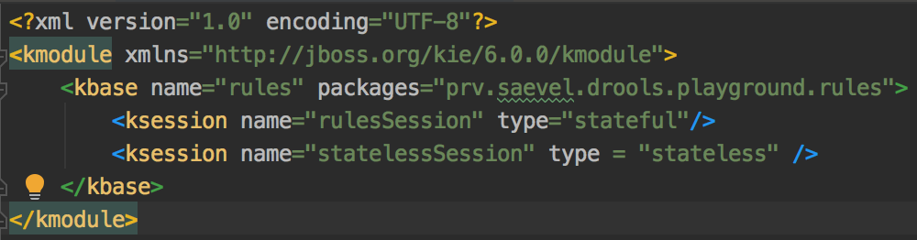
Drools Descriptor
Declaration of a Knowledge Base
META-INF/kmodule.xml
Stateful and stateless session
Notes:
Knowing the DRL files syntax, let’s have a look at things surrounding it and required to make it run. First, the kmodule.xml descriptor, which you have to place in the META-INF folder of your application. There, apart from the root “kmodule” tag, you declare kbases by nme, along with rule packages to be used and within them, Ksessions, also by name and defining the type as sateful or stateless, although if nothing is defined, then a session is stateful by default.

Slide 19
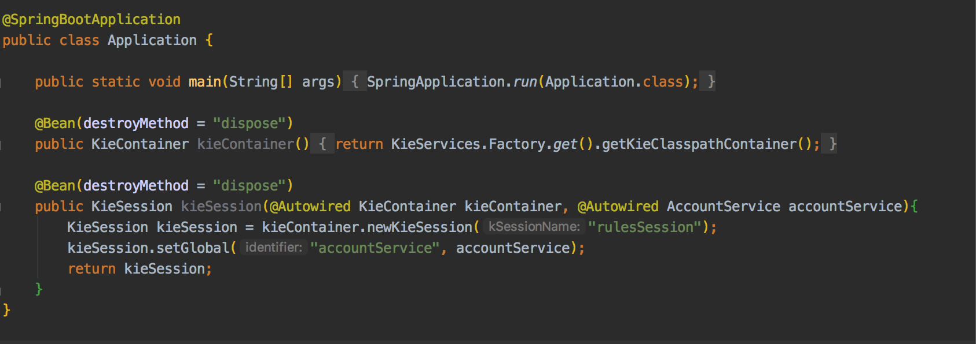
Creating Drools components with Spring
Drools-specific objects created in application context
Wire inject Java services and inject into Drools session as globals
Notes:
Then, there is a question of how to integrate Drools with a Spring application. Well, the best idea is to take a Spring Java-based context and define Drools objects as beans, really.
One, you create a KieContainer, from which you can create either sessions by name, or KieBases and session from them, all as injectable Spring Beans. Then, From KieSession can be created from those KieBases and you can use the KieSession object’s setGlobal method to add globals to be useable in Drools files.

Slide 20
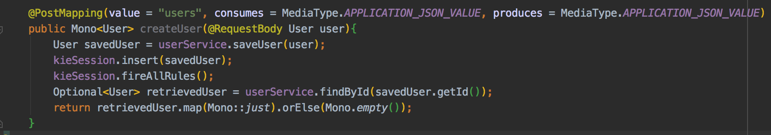
Triggering the rules
KieSession injected into the controller by Spring
Insert relevant facts as initial knowledge into the session
Trigger Drools rules
Notes:
Finally, let’s look at this piece of code from the controller. It has a KieSession injected under the name of “KieSession”. To build the initial domain, we need to take all the objects to be in it and call kieSession.insert for each one of them. Then, we can have all rules executed by calling “fire all rules”

Slide 21
Continuous Mode
Does not finish when there are no new activated rules
Re-evaluates when new data inserted, automatically
Useful for streaming / real-time processing
Notes:
Finally, in terms of triggering rules, there’s also something called “continuous mode”, where the Drools session doesn’t stop evaluating once there are no new rules triggered, but rather will continuously evaluate them, especially once a new element is inserted into the domain.
This is especially useful for streaming / real-time data processing ,where data that can trigger rules will arrive continuously and rules need to evaluate with very low latency.

Slide 22
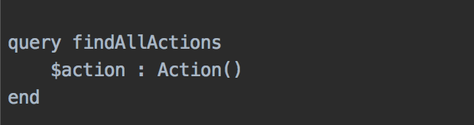
Queries
Preferred output mechanism from Drools (compared to globals)
Pattern match on domain objects and assign to variables
Those domain objects can later be retrieved from KieSession
Notes:
As Drools rules usually don’t send domain data outside, we still may be interested in final or current state of the data. For that

Slide 23
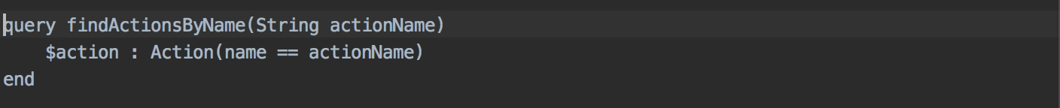
Parametrized Queries
Queries can take parameters
Submitted through the KieSession
You have to watch out for type safety

Slide 24
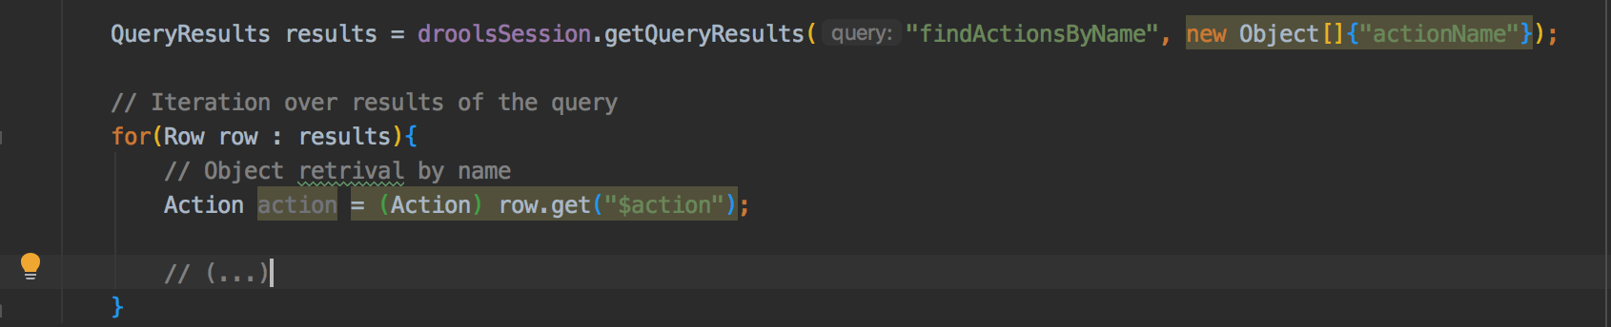
Query Result Retrieval

Slide 25
Live Queries
Queries for the continuous mode
Identical query syntax like regular queries
Used to create event-driven systems as output mechanism
NOTE: Regular queries via “getQueryResults” don’t work in continuous mode (BUG)

Slide 26
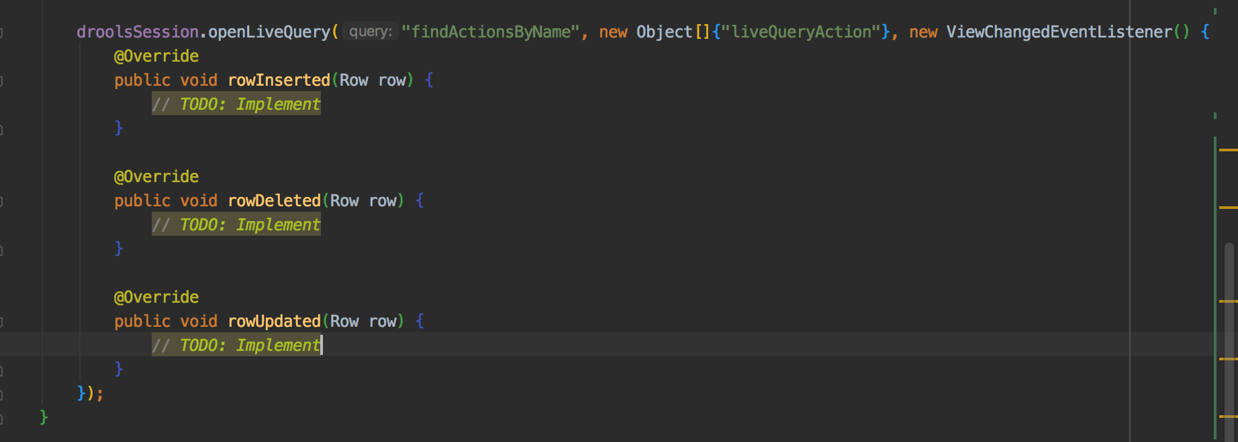
ViewChangedEventListener

Slide 27
Rules Design
Rules should never overtly call eachother
Inferences: Simple rules: understand low-level facts and update the domain with higher-level facts
Higher level rules: understand higher-level facts and execute external actions
Drools automatically manages the data dependencies between rules

Slide 28
Salience
An integer number signifying the priority of a single rule in the agenda
Simple, but error-prone

Slide 29
Agenda Groups
All rules with the same agenda groups have equal priority
Focusing on an agenda group move all its items to the top of the agenda

Slide 30
Activation Groups
ONLY ONE rule from a given activation group will be triggered
Useful for declaring rules with mutually exclusive conditions

Slide 31
Complex Event Processing
Rules evaluated in a time-continuous fashion
Ability to add new facts in real time
Essentially Drools integration for streaming

Slide 32
Declaring Java classes as events

Slide 33
Configuring Complex Event Processing in descriptors

Slide 34
Configuring Complex Event Processing in descriptors

Slide 35
Starting and stopping Complex Event Processing

Slide 36
Pattern matching on timed events

Slide 37
Pattern matching on timed events

Slide 38
Entry Points

Slide 39
Further Info
Starter project: https://github.com/Saevel/drools-playground
Consider: Persistence of Drools rules
Consider: Deployment & versioning of Drools rules
Further Reading: Mastering JBoss Drools 6
Further Reading: https://docs.jboss.org/drools/release/7.28.0.Final/drools-docs/html_single

